Slide 1
UMD Alumni Association

Slide 2
1.
Overview

Slide 3
Inroduction
The Alumni Association would like help in identifying the variables that are correlated to our desired outcomes of higher event attendance of first time attendees and major gift prospect attendees.
The data set provided is from 07/01/2013-11/30/2019 and contains 7 subsets of data, arranged by fiscal year (July 1-June 30).
The data set outlines each program or event hosted by the Alumni Association and provides general information on the event as well as the event registrants.
Each sheet in the data spans 14 columns providing information regarding the Activity, Group, Location and Event Participation

Slide 4
Methods
We achieved our goal by following the below methodology:
Cleaning the Data
Data aggregation and rendering
Data Mining using plots, graphs, analysis
Getting numbers and qualitative information from the analysis and plots
Combing the result to draw conclusions
Providing recommendations and future work

Slide 5
2.
Data Processing

Slide 6
Data Cleaning
We made the following changes to our dataset :
Split location description into location and region
Split group description into group purpose and audience
Removed leading and trailing whitespaces from all columns
Corrected any typos in text columns
Removed all duplicate sets in the activity, group and location columns
One row in AA FY 2019 had group and location data interchanged. We made corrections to that particular row

Slide 7
3.
Findings and Results

Slide 8
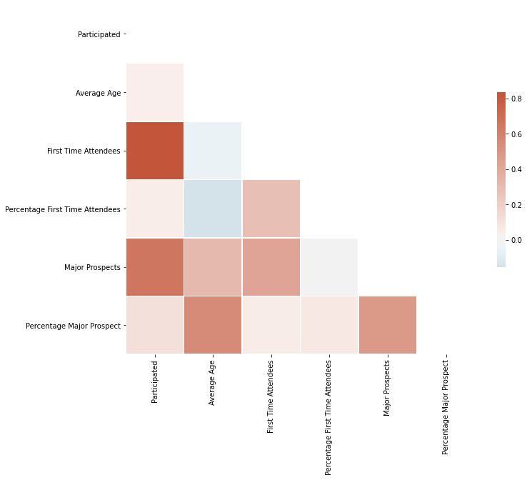
Correlation
High positive correlation between Major Prospects /First Time Attendees with number of Participants
Positive correlation between Major Prospects and Average Age
Negative Correlation between First Time Attendees and Average Age

Slide 9
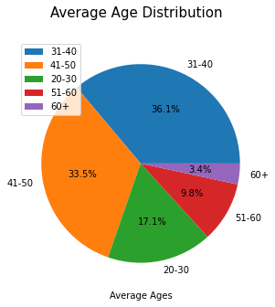
Average Age
A large proportion of events cater to the 31-40 and 41-50 age groups

Slide 10
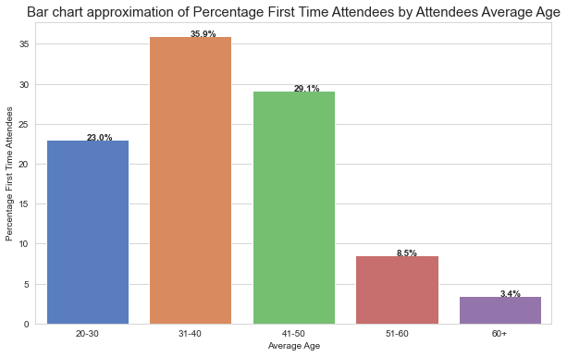
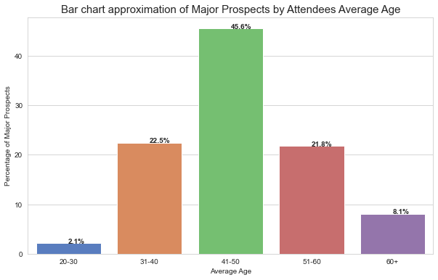
Average Age
Majority of the First Time Attendees and Major Prospects come from the 31-50 Age Groups

Slide 11
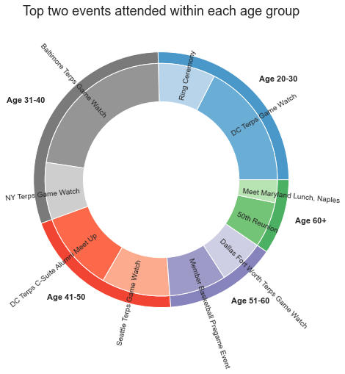
Average Age
Similar Events could attract high level of participation within each age group

Slide 12
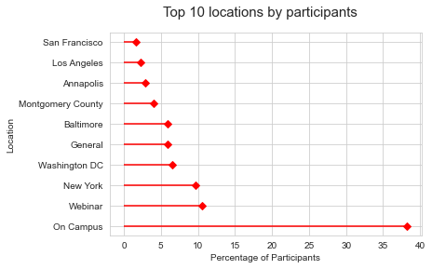
Location
Majority of the participants attend On Campus Events and events in the DMV Area

Slide 13
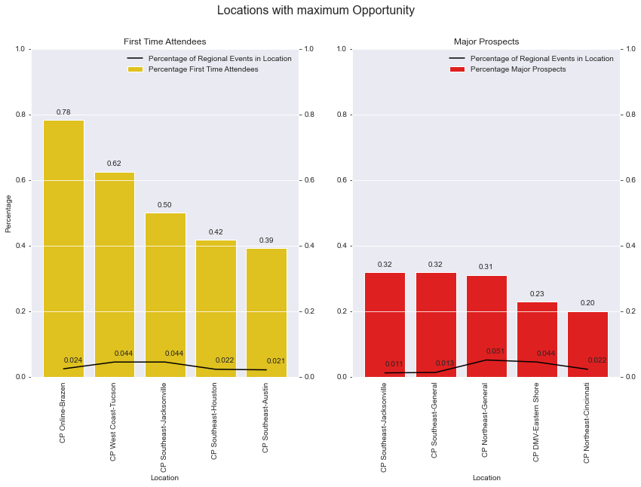
Location
Opportunity is defined as the difference between Average Percentage First Time Attendees or Major Prospects and the proportion of the events in that Region taking place in that specific Location

Slide 14
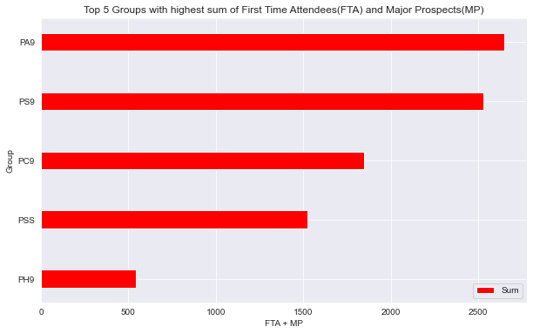
Group
Groups PS9 (CP Social - General) and PA9 (CP Athletics- General) have the highest number of combined First Time Attendees and Major Prospects

Slide 15
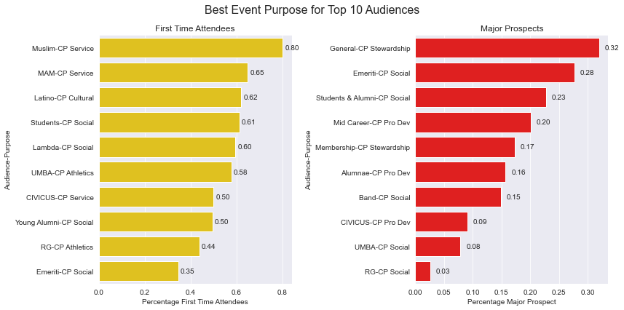
Group
We split Group Description into Event Purpose and Intended Audience.
CP Service and CP Social Events are successful for 6 of the Top 10 Audiences for First Time Attendees
CP Social and CP Stewardship Events attract majority of the top 10 Audiences for Major Prospects

Slide 16
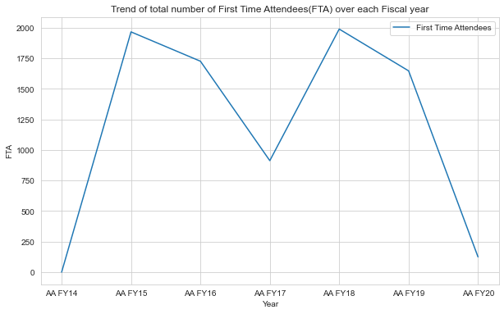
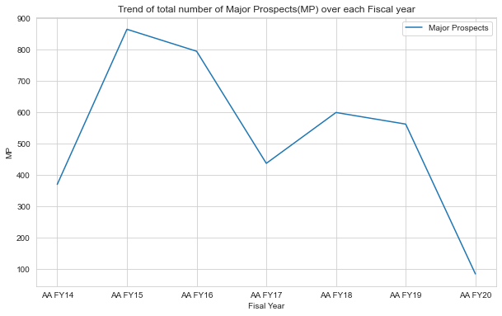
Time Period
After initial peak in 2015, the number of Major Prospects has declined throughout the years. No obvious pattern in number of First Time Attendees

Slide 17
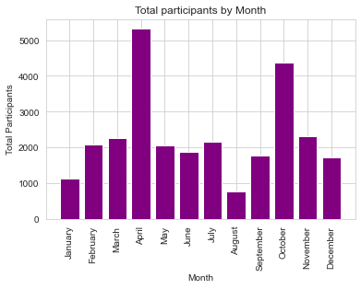
Time Period
The months of April and October attract the maximum number of Participants

Slide 18
4.
Future Work

Slide 19
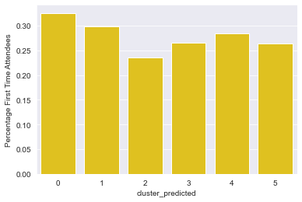
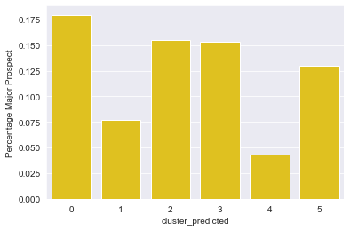
Clustering
Cluster the past events based on event attributes (Activity, Group, Location) to analyze similarity between events
Identify business definitions for each cluster and analyze distribution of First Time Attendees and Major Prospects in each cluster
The clustering done here is k-prototypes clustering. Based on a paper that came out in 1998 by Zhexue Huang which builds upon k-means.
Huang, Z. Extensions to the k-Means Algorithm for Clustering Large Data Sets with Categorical Values. Data Mining and Knowledge Discovery 2, 283–304 (1998). https://doi.org/10.1023/A:1009769707641

Slide 20
Thanks!
Any questions?

